Slide 1
start(presentation, ‘Monitoring Consoles System’);
andre-rato@~/uevora:
> Student: André Rato
> Company: DECSIS, Sistemas de Informação S.A.
> Supervisor in company: Danilo Andrade
> Supervisor in department: Pedro Salgueiro
André da Silva Rato
Computer Sciences Engineering @ Universidade de Évora

Slide 2
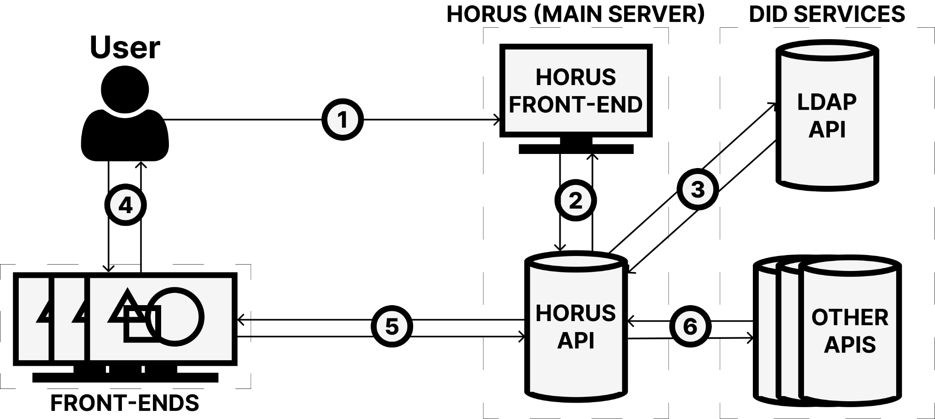
image(src: ‘./img/system’, size: ‘auto auto’);
André da Silva Rato
Computer Sciences Engineering @ Universidade de Évora

Slide 3
stage(1, ‘Acquire Knowledge’);
andre-rato@~/stage1:
> React.js
> Webpack.js
> Redux.js
> Axios.js
André da Silva Rato
Computer Sciences Engineering @ Universidade de Évora

Slide 4
stage(2, ‘Main Server’);
andre-rato@~/stage2:
> setup node project
> add express.js dependency
> integrate ldap
> implement a&a endpoints
André da Silva Rato
Computer Sciences Engineering @ Universidade de Évora

Slide 5
stage(3, ‘Front-end Cycle’);
andre-rato@~/stage3:
> learn the service
> create mocks
> setup react & webpack project
> implement endpoints @ main server
> implement components & unit tests
> test project
> write documentation
André da Silva Rato
Computer Sciences Engineering @ Universidade de Évora

Slide 6
present(to: did, get: feedback);
andre-rato@~/did:
> present
> get feedback
André da Silva Rato
Computer Sciences Engineering @ Universidade de Évora

Slide 7
get_improvements(system, [‘while’, ‘after’]);
andre-rato@~/improvements:
> while:
+ React.js states
+ Webpack.js config
> after:
+ security problems
+ high-load issues
+ non-responsive pages
+ deployment defects
André da Silva Rato
Computer Sciences Engineering @ Universidade de Évora

Slide 8
create([report, visual_support]);
andre-rato@~/create:
> create report
> create visual support for presentation (based on created report)
André da Silva Rato
Computer Sciences Engineering @ Universidade de Évora

Slide 9
present(to: [colleges, teachers, others], get: 20);
andre-rato@~/uevora:
> present
> system usage
André da Silva Rato
Computer Sciences Engineering @ Universidade de Évora

Slide 10
get(questions, time: ‘10 mins’);
?
André da Silva Rato
Computer Sciences Engineering @ Universidade de Évora

